Slide 1


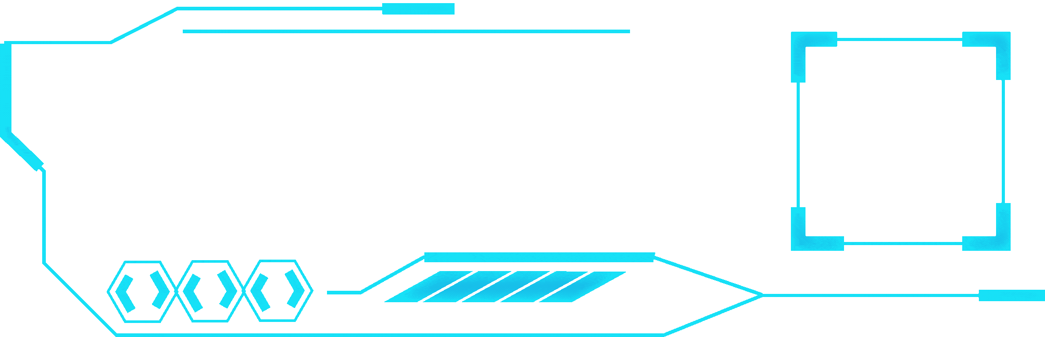


LINGUAL
SENSE
Deep Learning for Language Detection Across Texts

Slide 2

TABLE OF CONTENTS
PROJECT OVERVIEW
DATASET OVERVIEW AND KEY INSIGHTS
METHODOLOGY
EXPLORATORY DATA ANALYSIS
VISUALIZATION
DATA PREPROCESSING
FEATURE EXTRACTION
MODEL ARCHITECTURE
TRAINING AND EVALUATION
results
USER INTERFACE
CHALLENGES
FUTURE SCOPE
CONCLUSION

Slide 3


PROJECT OVERVIEW
OBJECTIVE:
To build a model that can automatically identify the language of a given text. Language identification is essential for various applications, including machine translation, multilingual document tracking, and electronic devices (e.g., mobiles, laptops).
OUTCOMES:
A trained deep learning model capable of predicting the language of input text
Improved accuracy in language detection for multilingual documents.

Slide 4

DATASET OVERVIEW AND KEY INSIGHTS
Structure: 2 columns: Text, Language.
Size: 32,337 rows, 2 columns.
Strengths: Comprehensive textual data with associated language labels.
REASON OF CHOOSING THE DATASET:
Comprehensive Textual Data: The dataset contains 32,337 rows of detailed text entries labeled with their respective languages, offering a rich source for textual and linguistic analysis.
Language Identification: Includes a 'Language' column that enables classification and segmentation tasks, which are essential for natural language processing and supervised model training.
Scalable for NLP Tasks: The large dataset size ensures robust training data, making it suitable for tasks like sentiment analysis, translation models, and text summarization.

Slide 5

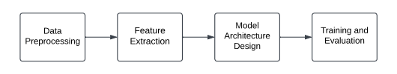
METHODOLOGY
DATA PREPROCESSING
Preparing raw data by cleaning, formatting, and organizing it for analysis.
FEATURE EXTRACTION
Converting data into meaningful representations suitable for modeling.
MODEL ARCHITECTURE EXTRACTION
Designing and implementing algorithms or architectures to solve the problem.
TRAINING AND EVALUATION
Training the model on data and measuring its performance using relevant metrics.

Slide 6
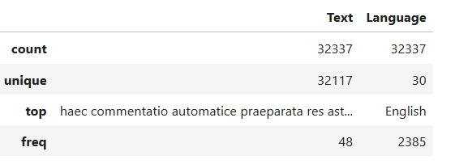

Exploratory Data Analysis
Inspected the structure and quality of the data using df.info() and df.describe()
KEY FINDINGS:
out of 32337 rows there are 32117 unique rows
There are 30 unique languages
English dominating other languages with 2385 entries

Slide 7
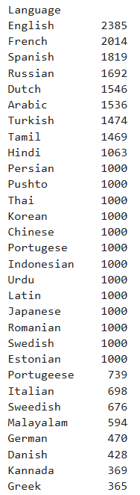
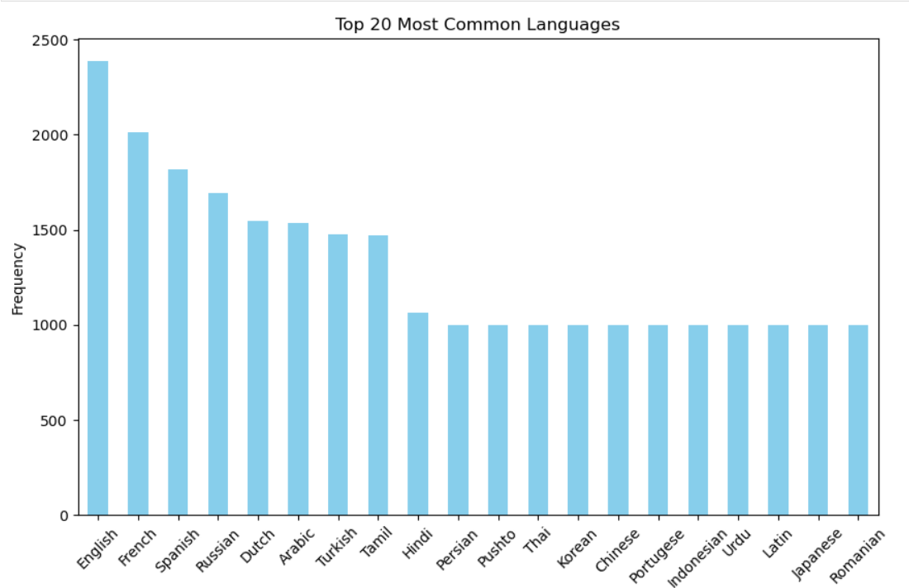
Visualization
English is the most frequent language , making up a significant portion (7.38%) of the total entries.
Greek is the least frequent language in the dataset, with only 365 entries, constitutes just 1.13% of the total dataset.

Slide 8
Data Preprocessing
1.REMOVED DUPLICATES:
Duplicates can artificially inflate the representation of certain data points,
leading to model bias. Hence,Identical text entries were identified and removed.
2.CLEANING THE TEXT DATA:
Regex-based cleaning was then applied to standardize the text by removing punctuation, non-alphanumeric characters, and extra spaces, resulting in a more uniform structure.
3.NORMALIZATION:
Finally, normalization was performed by converting all text to lowercase, ensuring consistency and reducing unnecessary variability in the dataset

Slide 9
Feature Extraction
1.TOKENIZATION:
The text data was transformed into numerical sequences, where each unique word was assigned an integer. This converts raw text into numerical form, enabling the model to process it.
2.PADDING:
To ensure all sequences had the same length, padding was applied to extend or truncate sequences to a maximum length of 100 words.
Padding ensures consistent input dimensions, which is essential for batch processing in neural networks.
3.LABEL ENCODING:
Language labels were converted into numerical form using LabelEncoder from sklearn. Each language was assigned a unique integer, making the categorical labels compatible with the model.

Slide 10
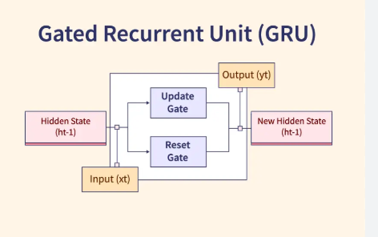
Model Architecture
The architecture is a sequential neural network built using Gated Recurrent Units (GRUs), which are efficient for handling sequential data like text. The focus is on extracting meaningful patterns from sequences to predict the language accurately.
LAYERS OF GRU:
INPUT LAYER
EMBEDDING LAYER
GRU LAYERS
DENSE AND DROPOUT LAYERS
OUTPUT LAYER

Slide 11
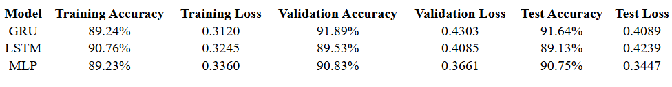
Training and Evaluation
During training, the dataset was divided into 80% for training and 20% for testing, with 20% of the training data used for validation. This approach ensures that the model’s generalization ability is fairly evaluated.
We trained three models: GRU, LSTM, and MLP, to evaluate their performance. GRU outperformed the others with the highest accuracy and efficiency, making it the best fit for our task.
While LSTM also performed well, it was more resource-intensive. MLP, being less suited for sequential data, had the lowest accuracy. Ultimately, GRU was chosen for its balance of performance and speed.

Slide 12
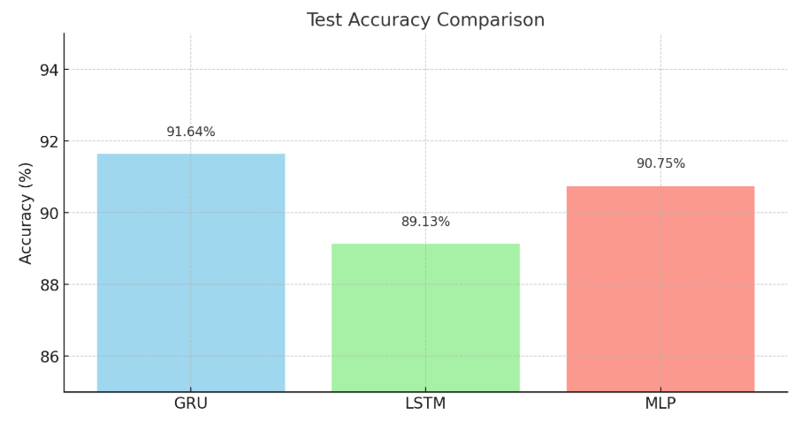
Results
GRU: Best overall accuracy and balanced performance, making it ideal for the task.
LSTM: Slightly lower accuracy but still a strong performer, particularly for more complex sequences.
MLP: Competitive accuracy and the lowest test loss, indicating robustness for simpler tasks.

Slide 13

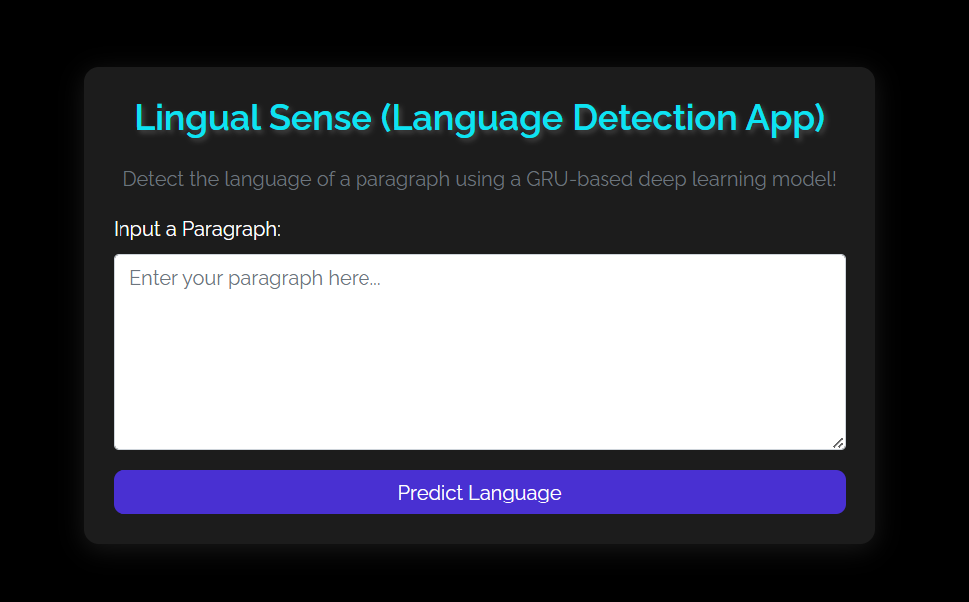
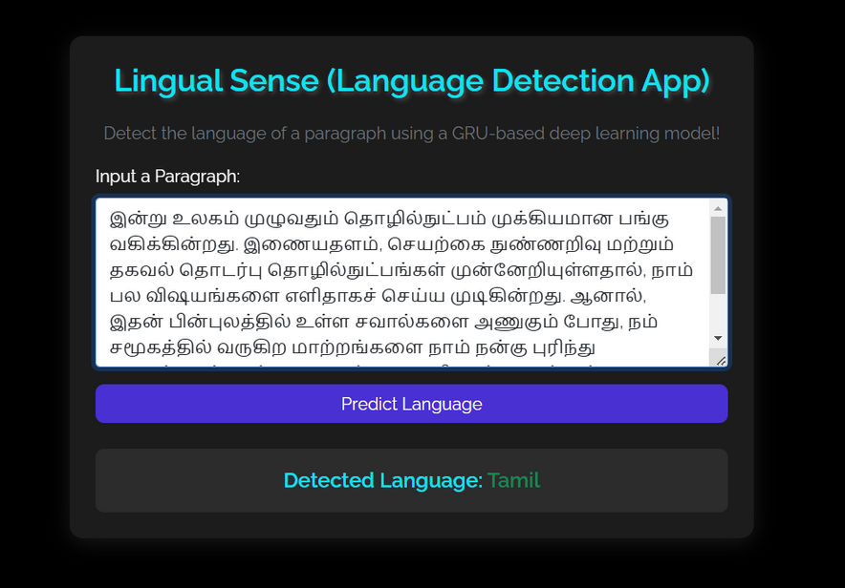
USER INTERFACE

Slide 14
Challenges
1.DATA IMBALANCE:
Certain languages had significantly more data than others, leading to potential bias in model predictions.
2.OVERFITTING:
Preventing overfitting, especially with a large number of languages and limited data for some classes, required careful regularization.
3.MULTILINGUAL NOISE IN DATASET:
Cleaning mixed-language text entries posed challenges for consistent language labeling

Slide 15
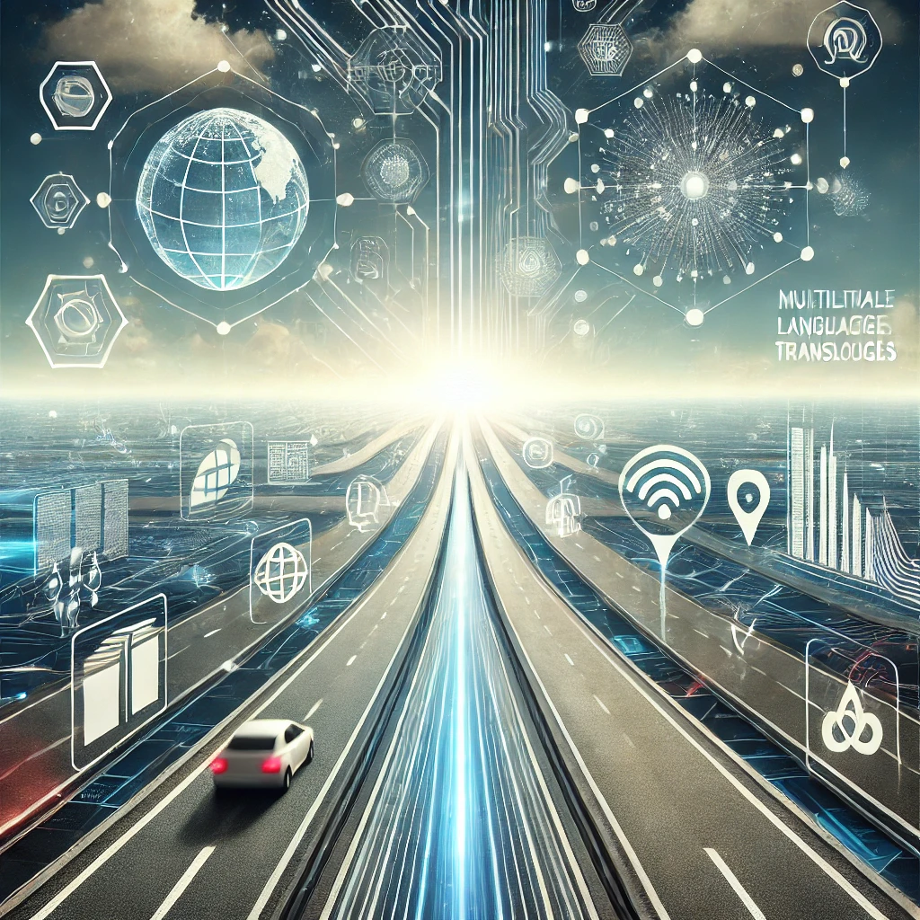
Future Scope
Expanding the dataset to include more underrepresented and rare languages to improve model versatility.
Deploying the model as a real-time application for detecting text language in social media, web content, and more.
Leveraging knowledge from high-resource languages to improve predictions for low-resource ones.

Slide 16

CONCLUSION
Successfully developed a deep learning model for accurate language detection across texts
Achieved robust performance with high accuracy and reliable evaluation metrics
Demonstrated the importance of language detection in multilingual document processing and its applications in real world scenarios

Slide 17


THANK YOU

